Slide 1
SV8100 – Management
Pre-Sales Support
UNIVERGE SV8100
Release 9
Doc. Version 9.01

Slide 2
Overview
PCPRO
Offline Programming with PC application
Graphical User Interface
Offline
WebPro (UserPro)
Programming via Web interface
Graphical User Interface
Changes are immediately effective
End UserPro
Phone Programming
Programming via System Phone
Coded commands
Changes are immediately effective

Slide 3
PCPro
Offline Programming with PC application
Graphical Interface
Data can offline be prepared and Uploaded later to the SV8100
Data can be downloads
Easy to make Backup
Programming
Wizzard at 3 levels
Mandatory
Optional
Advanced
System data Programming
Only to be used by experienced engineers
Help Information
Contains features and Specification Manual

Slide 4
Graphical Interface
PCPro
Main menu
Toolbar
Wizzards
Submenu
Work space
Status bar

Slide 5
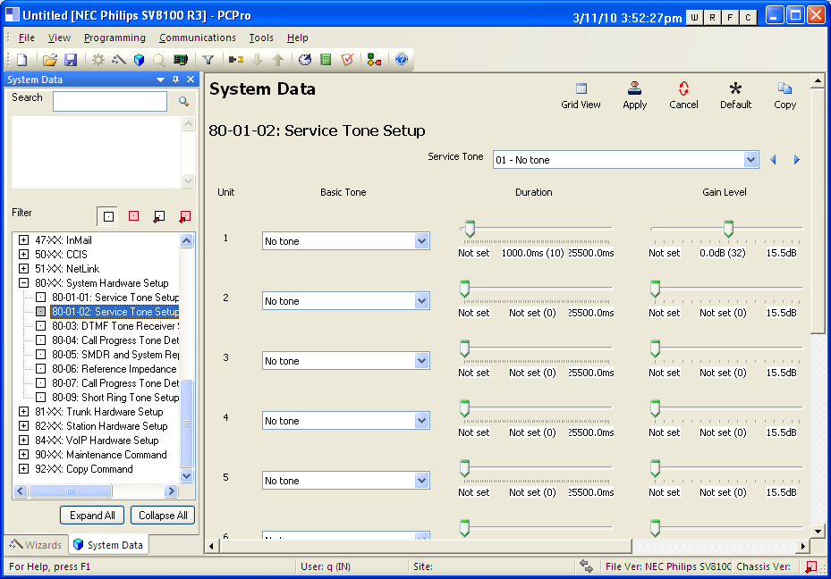
System data Programming
PCPro
Program Codes

Slide 6
Connection
PCPro
Connecions
LAN For security reasons the local CPU-IP port can be used i.s.o. the VoIP port
Remote ISDN-BRI connect to a build-in ISDN Modem (DDI to 308)
Password protected User Accounts
4 User levels
Tech Installer Mode (IN)
System Administrator Mode 1 (SA)
System Administrator Mode 2 (SB)
User Administrator (UA)
1 session active at a time
Each User Accounts can define a range of Connection accounts

Slide 7
WebPro
WebPro
Connect via Web browser tot the SV8100
Maintenance interface integrated in the SV8100
No special software needed of pc of System Administrator
Changes are Immediately effective
Save and restore System of System database
Save in Compressed file (.gz)
file can not be viewed within Webpro
After Uncompress it can be viewed in PCPro
Upgrade SV8100 Main Software
PZ-ME50 card required
NO USB memory required

Slide 8
WebPro
Connecion
LAN For security reasons the local CPU-IP port can be used iso the VoIP port
Remote ISDN-BRI connect to a build-in ISDN Modem (DDI to 308)
Password protected 2 access levels
System Administrator (UA Level)
System wide changes
User (UB Level) (UserPro)
Only allowed to make changes for that extension that that logs in (Ext. nr. is login name)
Can be translated in local language
4 sessions active at a time

Slide 9
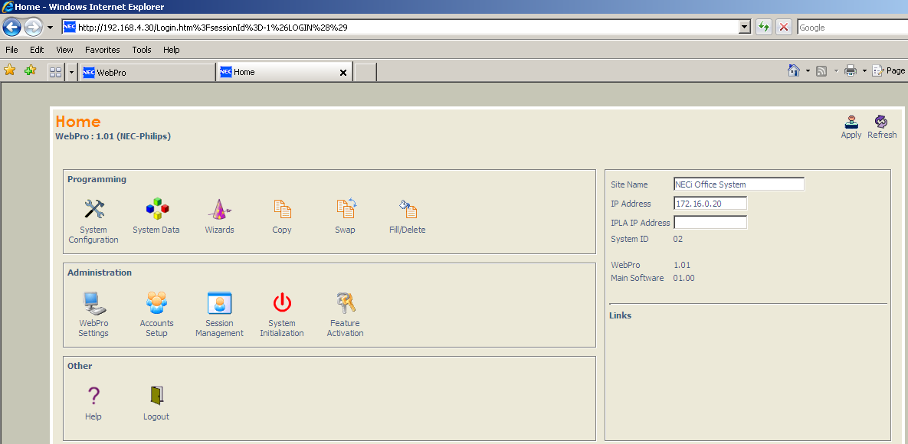
WebPro

Slide 10
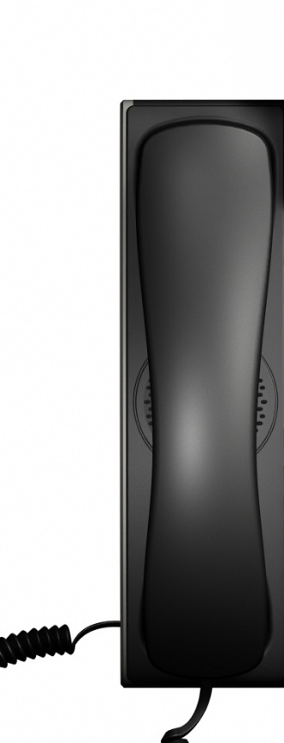
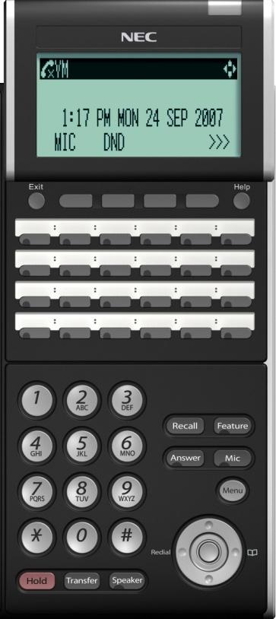
Phone programming
Program the SV8100 via a system Phone
Use codes as used in PCPro System data programming eg 15-22-01 (Mobile extension setup)
Enter Command Mode by prseeing SPK #*#* “Password” Transfer
Use Keys to navigate through programming
Transfer = Store/Next
Hold = Clear
Answer = Back
MIC = Scroll
SPK = Exit
Navigation button
Up = Next port
Down = Previous port
Left/Right = Name edit

Slide 11
PCPro Practical
Confirm IP Address of system
10-12-01 Ethernet connection
10-12-09 IPLA Connection
Notes:
10-12 -01 CCPU, 10-12-09 IPLA

Slide 12
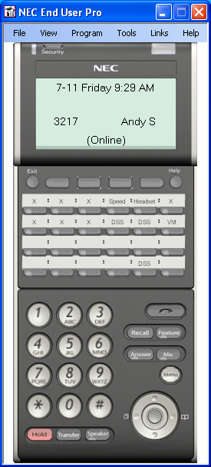
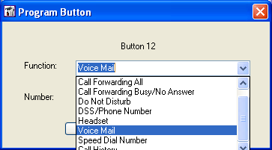
End User Pro
One of the installable add-ons from the Desktop Suite
Shows phone details and allows programming of own function keys

Slide 13
IP Phone Manager
Way of working:
Specify subnet
Search IP phones which comply with the search algorhytm
Upgrade firmware to these phones
Telephone management:
IPPhone Manager – upgrade DT700 phones with new firmware
PCPro – change settings (e.g. button progr.) on individual phones

Slide 15
Document History
17-03-2011 .
Copyright statement changed
29-05-2013 Doc. Version 9.00
Webpro enhancements (save configuration, Upgrade firmware)
User Pro can easily be translated in Local Language
04-06-2013 Doc. Version 9.01
Desktop Suite End User pro added

